Slide 1
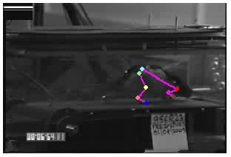
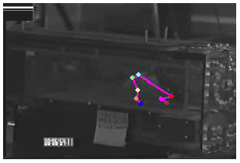
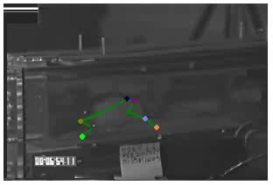
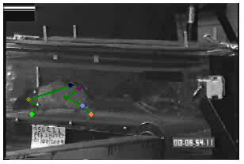
3D Kinematics Treadmill Testing
Pre-Injury
Camera One –Right Side Camera Two – Right Side
Camera Three – Left Side Camera Four – Left Side

Slide 2
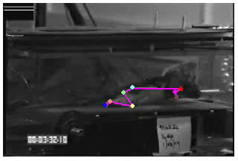
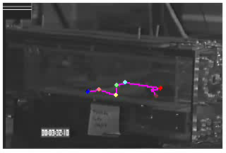
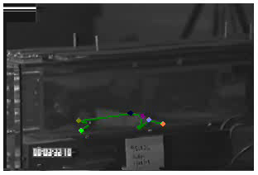
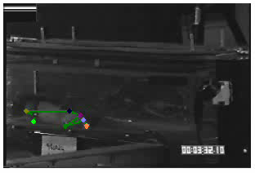
3D Kinematics Treadmill Testing
Pre-Injury
Camera One –Right Side Camera Two – Right Side
Camera Three – Left Side Camera Four – Left Side

Slide 3
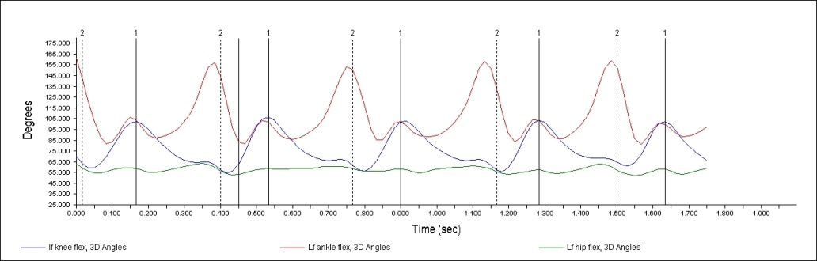
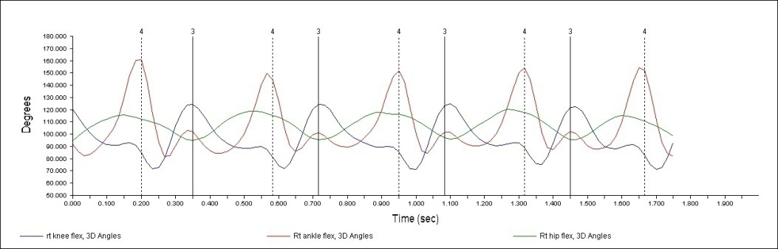
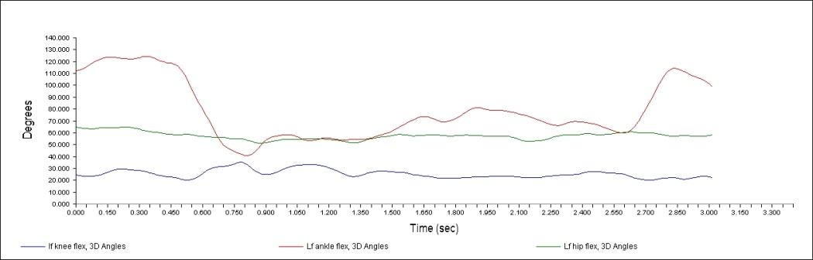
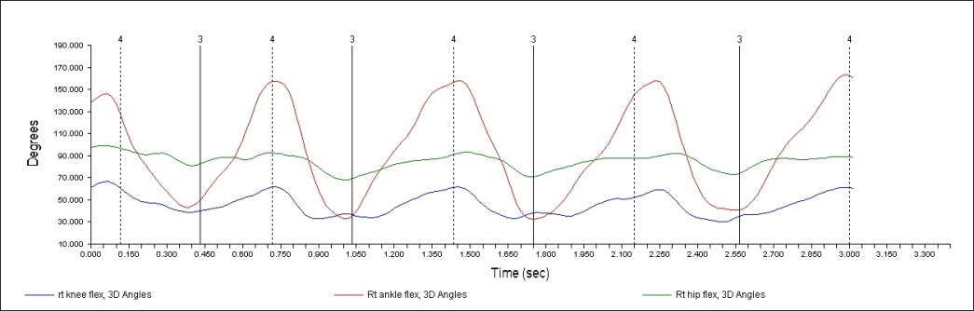
Hindlimb 3D Angle Plots for in
Pre- and Post-Injury Animals
Pre-Injury
Left Hind Limb Right Hind Limb
Post-Injury
Left Hind Limb Right Hind Limb

Slide 4
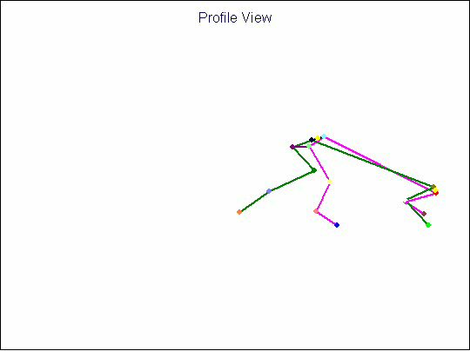
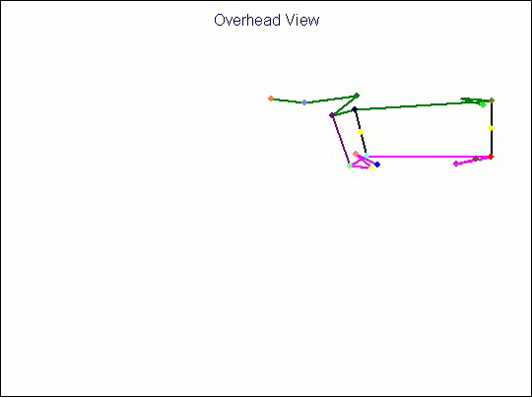
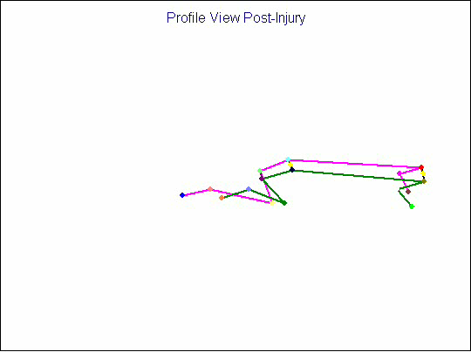
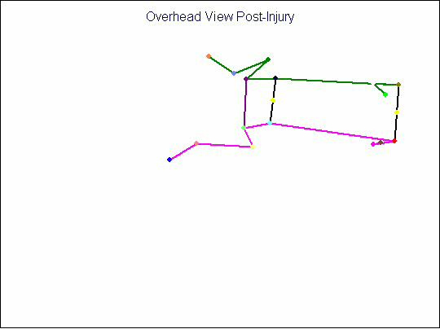
Pre-Injury
Post-Injury

Slide 5
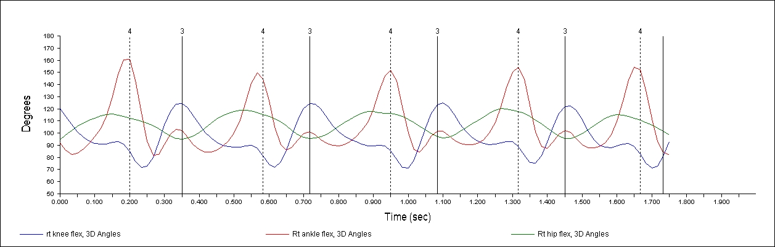
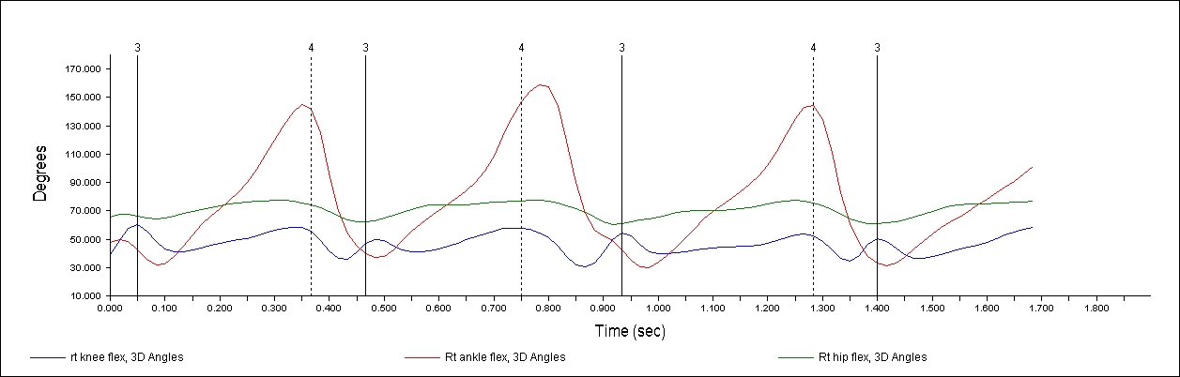
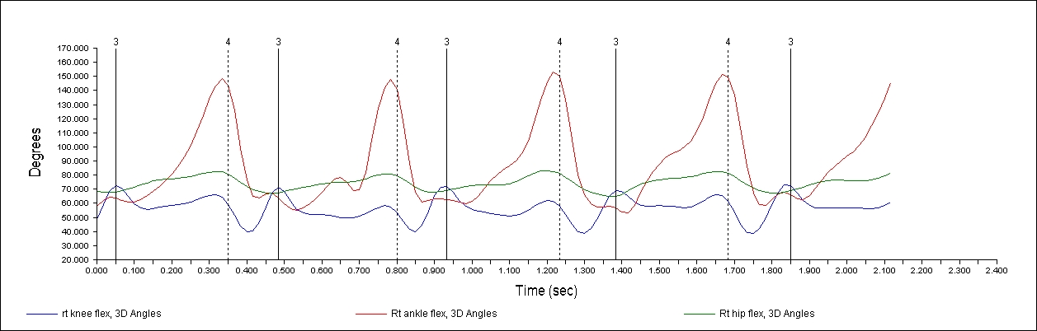
Pre Injury
Right Hind Limb
Angles
14 dpi
Right Hind Limb
Angles
42 dpi
Right Hind Limb
Angles

